Slide 1
Phishing Lab

Slide 2
Phishing Lab
Materials needed
Kali Linux Virtual Machine
Windows 7 Virtual Machine
Software Tools used (On the Kali Linux OS)
SET (Social-Engineering Toolkit)

Slide 3
Objectives Covered
Security+ Objectives (SY0-501)
Objective 1.2 – Compare and contrast types of attacks
Social Engineering
Phishing
DHS CAE Units
CTH – Describe different types of attacks and their characteristics

Slide 4
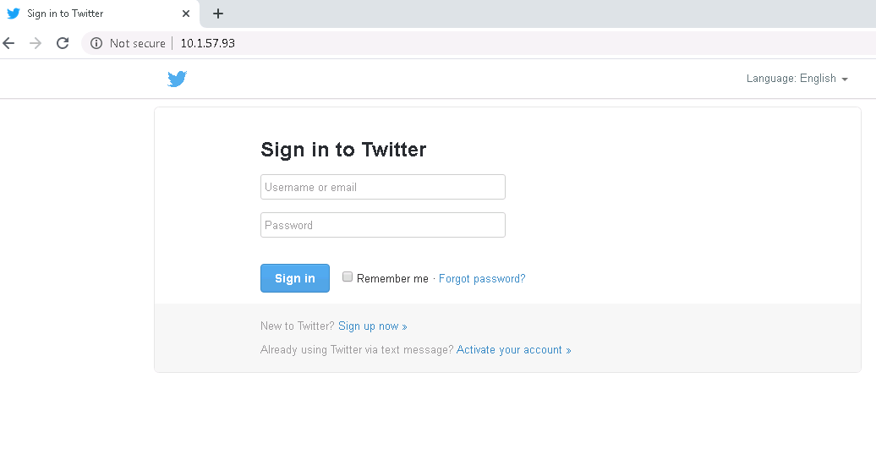
What is a Phishing Attack?
Attempting to get information from someone in a malicious manner
An example, a phishing attack can send someone to a fake website to try and have them use credentials for the real website
Here, this website is made to look like the log-in page for Twitter, but notice the URL
Notes:
Bank: Chase
Username: jsmith17 Password: @pp13s33d

Slide 5
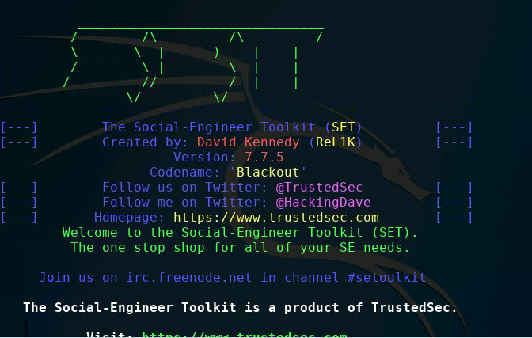
The Phishing Lab
Set up Environments
Find IP Addresses
Verify Connection
Open SET Toolkit
Launching the attack
Playing the victim
Seeing the attack

Slide 6
Setup Environments
Log into your range
Open the Kali Linux and Windows 7 Environments
You should be on your Kali Linux Desktop
You should also be on your Windows 7 Desktop

Slide 7

Find the IP Address (Kali Machine)
You will need the IP address of the Kali machine
Open the Terminal
In the Linux VM, open the Terminal and type the following command:
hostname -I
This will display the IP Address
Write down the Kali VM IP address
The IP Address

Slide 8
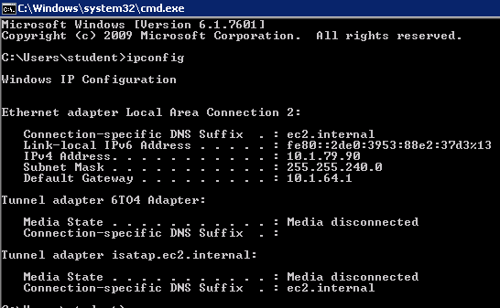
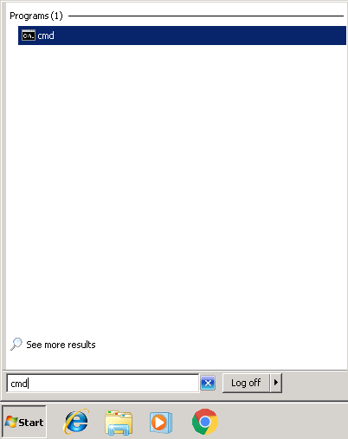
Find the IP Address (Windows Machine)
Select the Start button (Windows Machine) and search for “cmd”
Open cmd (Command Prompt)
Use the following command:
ipconfig
Search for the IPv4 Address line
Write down the Windows IP Address
Windows IP Address

Slide 9
Verify Connection
Verify that the Windows Environment is connected to the Kali environment
In Kali’s Terminal, type the following command:
ping –c 4 WINDOWS_IP_Address
In the Window’s VM, open the Command prompt
Press the Start Button
Search for “CMD”, open the Command Prompt
Type the following Command:
ping Kali_IP_Address
Entering the actual IP Address where the green text is
You should notice the two systems are able to communicate with each other

Slide 10
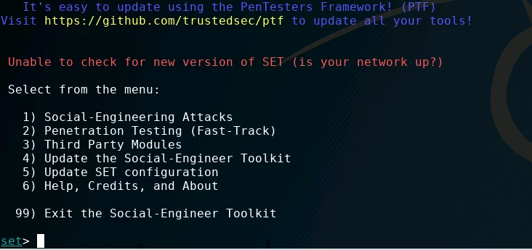
Open SET Toolkit
In the Kali environment, open Terminal
Enter the following command to open the SET Toolkit:
sudo setoolkit
When asked if you agree to terms and conditions, type y and press ENTER.

Slide 11
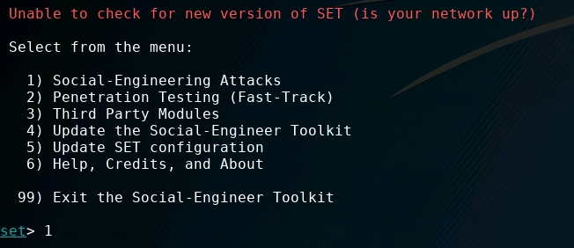
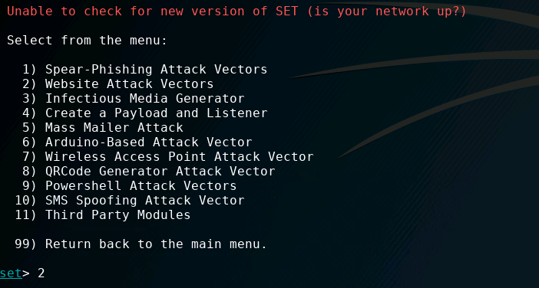
Launching the Attack
In the SET Toolkit, you will select what attack you want to run.
Press 1 and ENTER to open the Social-Engineering Attacks
Once the Social Engineering Attacks load, press 2 and ENTER to open the Website Attack Vectors

Slide 12
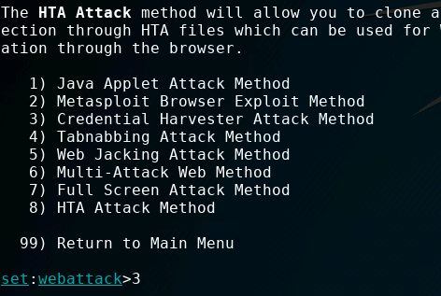
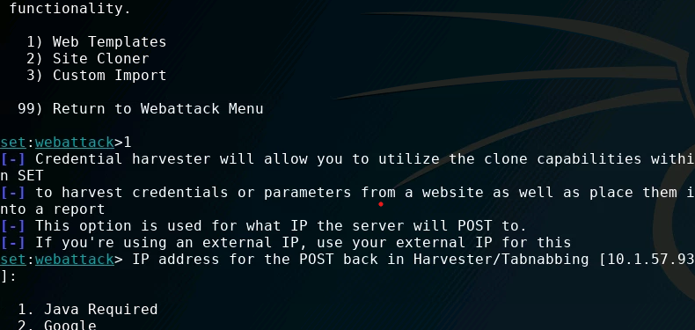
Launching the Attack
Once the Website Attack Vectors load, press 3 and ENTER to run a Credential Harvester Attack
Now, we are going to use the Web Templates, so press 1 and ENTER
Verify that the IP Address is the same as your Kali’s IP Address, and press ENTER again

Slide 13
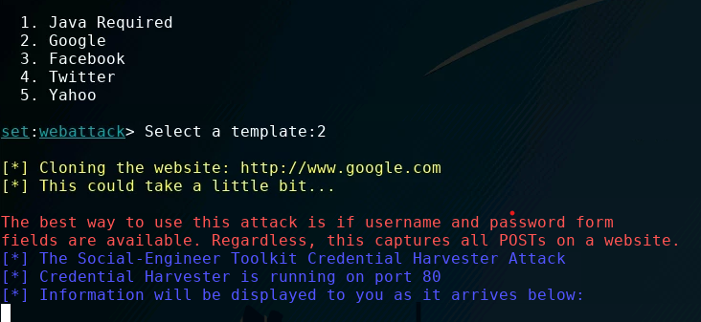
Launching the Attack
To set the site up as a Google login page, press 2 and ENTER
You should see that the attack is running and “Information will be displayed to you as it arrives below”

Slide 14
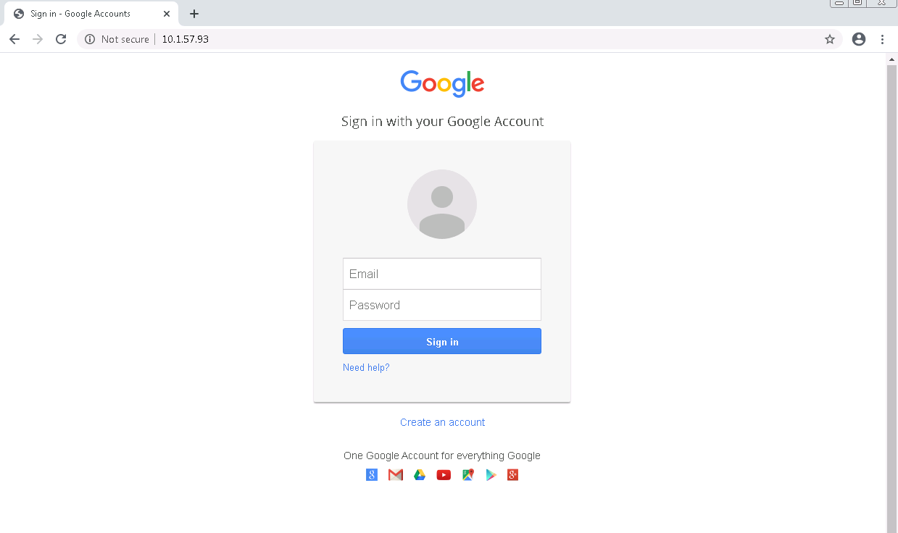
Playing the Victim
In the Windows environment, open the Chrome Browser
Go the website of the URL for Kali
Kali-IP-Address (as the URL)
Notice that this looks exactly like a login page for a standard Google account

Slide 15
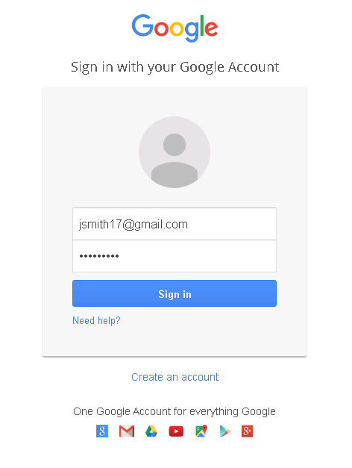
Playing the Victim
Now, type in fake credentials to this webpage as if you were going to log into a Google account
Notice, once you log in, it simply takes you to www.google.com, but you are not signed into Google.

Slide 16
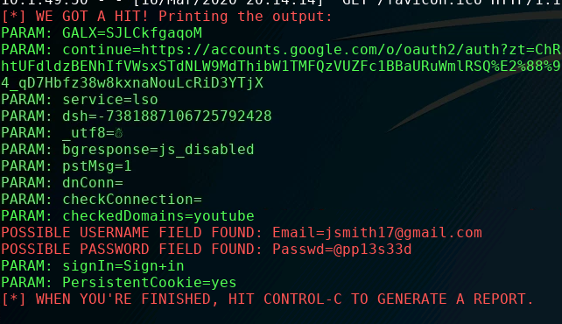
Seeing the Attack
Go back to Kali
It should show you that it has “GOT A HIT!” and will show the username and password in plaintext

Slide 17
How to Defend Against a Phishing Attack?
Only use credentials at trusted websites!
What was the website URL you entered your credentials in?
Watch for "watering hole" type attacks at sites that look similar to your intended destination
Avoid re-using passwords across multiple websites
If one site steals your password once and they're all the same...
Two-Factor Authentication
Why would these help secure your password?
What are some other ways of defending against a phishing attack?

